Slide 1
.net Tutorial Part 01
Introduction to .net
Introduction to Web Forms

Slide 2
Our Software
We will be using Visual Studio 2017 Community Edition
It can be downloaded from:
https://www.visualstudio.com/downloads/

Slide 3
About .net
Software framework developed by Microsoft
Began as a framework for Windows Applications supported only by Windows
In 2014, Microsoft announced they were going to strive for cross-platform support

Slide 4
ASP.net vs ASP.net Core
ASP.NET Core
ASP.NET Core is an open-source, cross-platform framework for building modern, cloud-based web applications on Windows, macOS, or Linux.
ASP.NET
ASP.NET is a mature framework that provides all the services needed to build enterprise-class, server-based web applications on Windows.
Note: ASP.net Core is not a continuation of ASP.net. It is a whole new framework.
A lot of speculation is saying ASP.NET Core will make ASP.NET almost obsolete in the future (similar to how ASP.NET replaced Classic ASP)
Currently, ASP.NET 4.6 is the more mature platform. It’s been around longer and been battle-tested. But the future is changing…

Slide 5
ASP.net vs ASP.net Core
ASP.NET | ASP.NET Core
Windows | Windows, Mac, or Linux
Develop with Visual Studio (C#, VB, or F#) | Develop with Visual Studio, Visual Studio for Mac, or Visual Studio Code
Good performance | Higher performance than ASP.net
Can use Web Forms or MVC for UI | No Web Form option, MVC using Razor Pages is the suggested UI approach

Slide 6
ASP.NET Web Forms
Loved by many because of the quick, simple approach to UI design (gotta love drag-and-drop)
Often used as a tool for the RAD (Rapid-application development) approach
RAD approaches emphasize adaptability and the necessity of adjusting requirements in response to knowledge gained as the project progresses.
Prototypes are often used in addition to or sometimes in place of design specifications
Especially well-suited for developing software that is driven by user interface requirements.

Slide 7

ASP.NET Web Forms
Criticized by many because it is not as lightweight as MVC. It contains “bulky” pre-built UI components.
ASP.net Core does not support Web Forms

Slide 8
ASP.NET Web Forms
Development supports state • Gives the illusion that a web application is aware of what the user has been doing, similar to Windows applications. I.e. Makes 'wizard' functionality a little bit easier to implement. Web forms does a great job at hiding a lot of that complexity from the developer.
Rapid Application Development (RAD) • The ability to just 'jump in' and start delivering web forms. This is disputed by some of the MVC community, but pushed by Microsoft. In the end, it comes down to the level of expertise of the developer and what they are comfortable with. The web forms model probably has less of a learning curve to less experienced developers.
Larger control toolbox • ASP.NET Web Forms offers a much greater and more robust toolbox (web controls) whereas MVC offers a more primitive control set relying more on rich client-side controls via jQuery (Javascript).
Mature • It's been around since 2002 and there is an abundance of information with regards to questions, problems, etc. Offers more third-party control - need to consider your existing toolkits.

Slide 9
Creating Project using ASP.net Web Forms
Open Visual Studio 2017
Choose File → New → Project
Expand Installed → Visual C# → Web and choose ASP.NET Web Application (.NET Framework)
Note: If you don’t get this option, you missed installing the right package. You can launch the installer to install the package by clicking the link “Open Visual Studio Installer”
Make sure under Web & Cloud you have the ASP.NET and web development box checked.

Slide 10
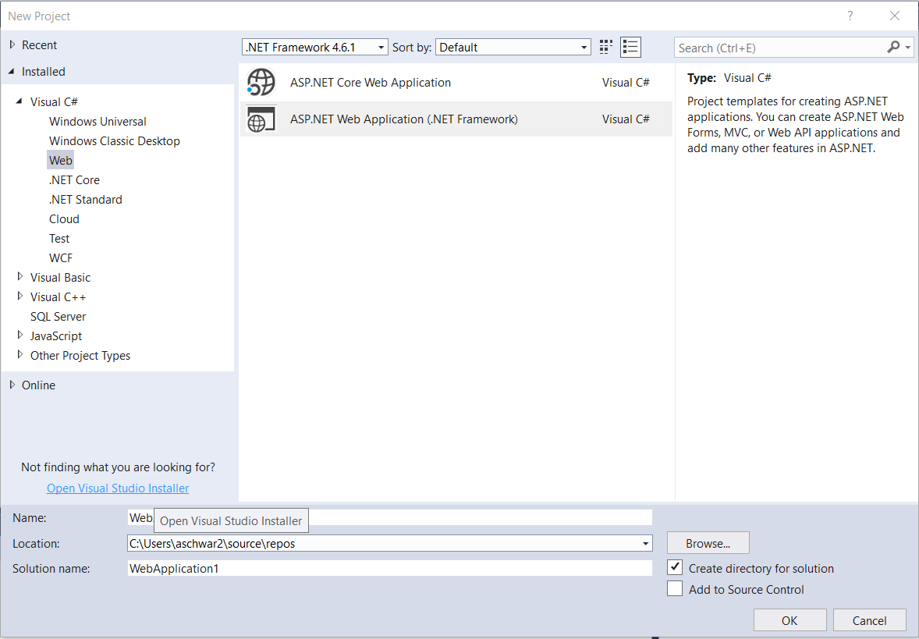
Creating Project (ASP.NET Web Forms)

Slide 11
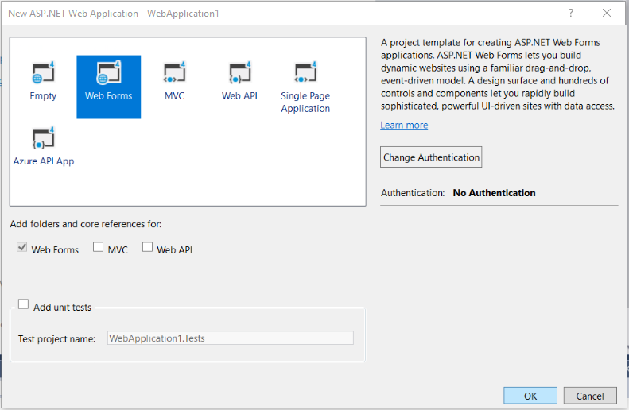
Creating Project (ASP.NET Web Forms)
Choose Web Forms on the next screen and click OK.

Slide 12
Running a Project in Visual Studio
When you create your project, it comes with a bunch of files and folders already created.
Let’s take a look at what the starter site looks like by running the project
You can run the project by:
Clicking Debug → Start without Debugging or clicking Ctrl + F5

Slide 13
Master Pages
Master Pages are used to maintain a consistent look and feel over a website
Manages the header, footer, and background of the site for all pages
The Web Forms just need to specify it has a master page.
Let’s play around with Site.Master

Slide 14
Master Pages
An application can have many different master pages and the pages can even be nested.
For example, you might have a master page for logged out users, and a master page for logged in users.

Slide 15
Web Forms
This fills the “main” part of the page
Check out Default.aspx, Contact.aspx, and About.aspx
In the Page tag you will see:
MasterPageFile=“~/Site.Master”
this specifies to use the master page site.master and therefore use the layout specified in the page.

Slide 16
Web Forms
Two main parts:
A view (UI) (.aspx)
Mixes HTMl and C# syntax
Code-behind (Server code) (.aspx.cs)

Slide 17
Web Forms – Creating a New Form
Right-Click on your project, Click Add → New Item
Under Web, choose Web Form with Master Page
Note: if you do not want the page to use a Master Page, you can just choose Web Form.
Click Add and choose the master page
Let’s add a link to the new page
Add some content to your new page
Add the link in Site.Master
Run your project & click on the new link

Slide 18
Drag-and-Drop GUI
Open the Toolbox
Let’s take a look at some controls

Slide 19
User Controls
Another reuse mechanism
Also 2 parts:
UI (.ascx)
Code behind (.ascx.cs)
Like a tiny, portable .aspx page that can be put inside of other pages
For example, if you have to have a drop-down for selecting a brand of car all over your site, all you need to do is build a user control and then add to whatever pages you need it on
This way if you make a change, it’s changed everywhere

